Slide 1
SKILLCOURT 6.0
April Perry Pedro Carrillo Jofran Duran Rolando Ramos
Advanced Software Engineering – Fall 2016

Slide 2
PROBLEM
SkillCout Project:
Create an interactive soccer simulation application that provides a range of customizable options for a more profound platform for player training and coach interaction.
Previous iterations coded as a Java PC application that needed to be wired to the SkillCourt device in order to play a game.
Limitations
Not much room for extensibility
Wireless connectivity needed!
No post-play or coaching interaction
Simple model

Slide 3
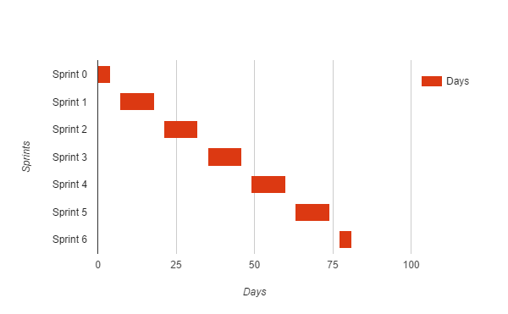
PROJECT MANAGEMENT – TIMELINE, FALL 2016

Slide 4
USER STORIES
JAVA -Play again option -Beat timer game mode -Start game > 60 seconds
________________________ ANDROID APP _______________________
Login
Register
Create User Sequence
Enroll as Coach
View History
View Detailed History
View and Create Teams
View graphical Statistics
Search and Add users
Start a game
Shows Sequences in dropdown
Beat Timer Game Mode
Pull live stats from repo
View Detailed History
View and Create Teams
View graphical Statistics
Search and Add users
Start a game
See History of my Team(s)
Show Dashboard
Refactor Stats Code
Move Sequences to Create Game

Slide 5
USE CASE
(April)
“Pull live STATS from database to populate graphs”
Participating Actors: Player
Entry Condition: User wishes to view REAL TIME graphs representing the accumulated statistics of their SkillCourt play thus far
Events Flow: Player clicks “Statistics” button on main dashboard. Player can scroll up and down to view different real time graphical data displays
Notes:
Make sure to update the title line in the footer. To do this, simply:
Click on View
Click Side Master
Edit the title line in the footer. Note: you will need to make the edit on each slide in the “master”. This should take less than 5 minutes.

Slide 6
“Play a game #803”
Participating Actors: Player
Entry Condition: A player wishes to play a game in skill court to improve his soccer skills
Events Flow:
User wants to start a game
User configures his game
User starts playing his game on a picked Game mode
USE CASE
(Pedro)

Slide 7
“View and Add Teams #830”
Participating Actors: Coach
Entry Condition: The coach wants to see all the teams he has created and wants to create new teams
Events Flow:
The coach hits the Coaching button on his dashboard.
Then the coach can see all the teams he has created as a list
The coach can add a new team by clicking the plus button in the right lower corner
The coach add the new team name and description and press save; then the app takes him back to the list of teams.
USE CASE
(Jofran)
7

Slide 8
USE CASE
(Rolando)
“Move Sequences to Create Game page #912”
Participating Actors: Player
Entry Condition: User wants to see/save sequences in dropdown
Events Flow: Player will see dropdown populated with sequences name.
Player can select/save default sequence
Notes:
Make sure to update the title line in the footer. To do this, simply:
Click on View
Click Side Master
Edit the title line in the footer. Note: you will need to make the edit on each slide in the “master”. This should take less than 5 minutes.

Slide 9
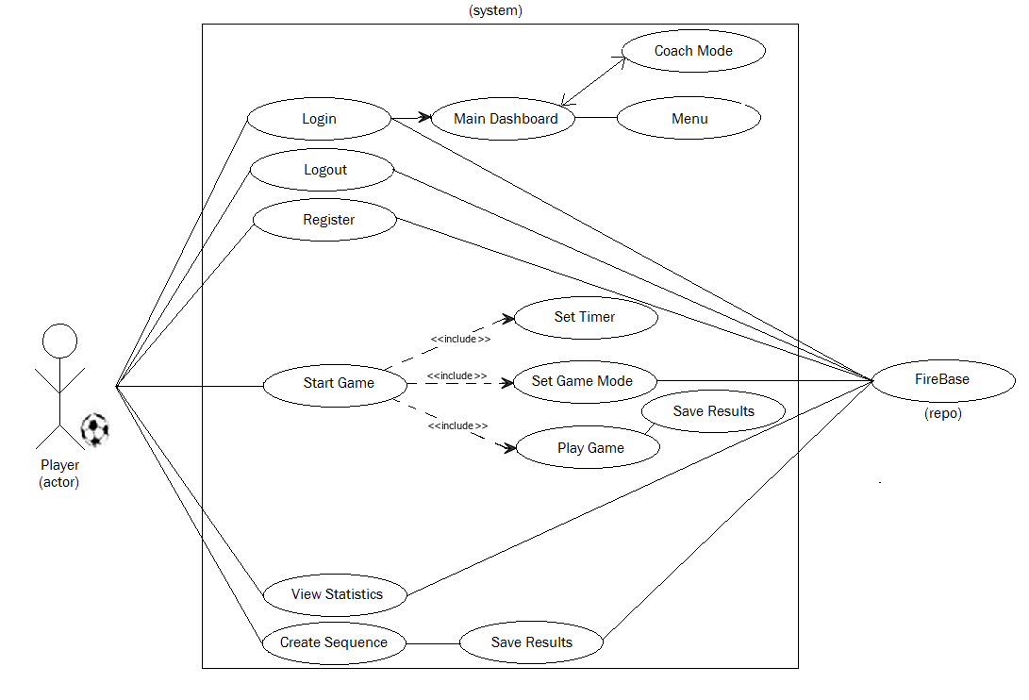
UML USE CASE DIAGRAMS…
A high level overview of the new SkillCourt Android App functionality

Slide 10
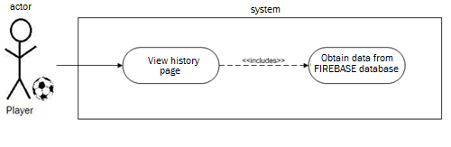
UML USE CASE DIAGRAMS…
Breakdown of an individual Use Case
(User Story #896 – “As a PLAYER, I would like to be able to view the LIVE statistics that I have saved, so that the graphs that I am viewing on the STATS page are accurate in relation to my individual progress.”)

Slide 11
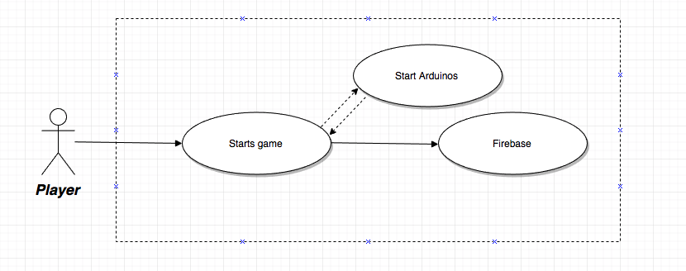
UML USE CASE DIAGRAMS…
Breakdown of an individual Use Case
(User Story #803 - “As a PLAYER I would like to start a game from my android phone to start practicing my skills on SkillCourt”)
11

Slide 12
UML USE CASE DIAGRAMS…
Breakdown of an individual Use Case
(User Story #830 As a coach I would like to be able to create teams within my profile and see them listed so that I can follow the progress of the players I’ve added to those teams.)
12
12

Slide 13
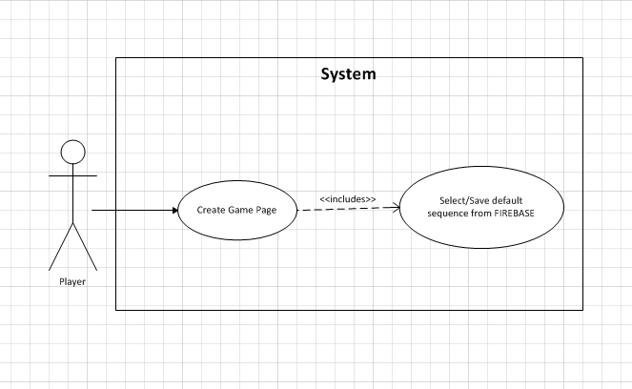
UML USE CASE DIAGRAMS…
Breakdown of an individual Use Case
(User Story #912 - As a PLAYER, I want the ability to see the sequences in a drop down in the create game page and select a default one before starting a game, so I can test my abilities using that specific sequence)
13
13
13

Slide 14
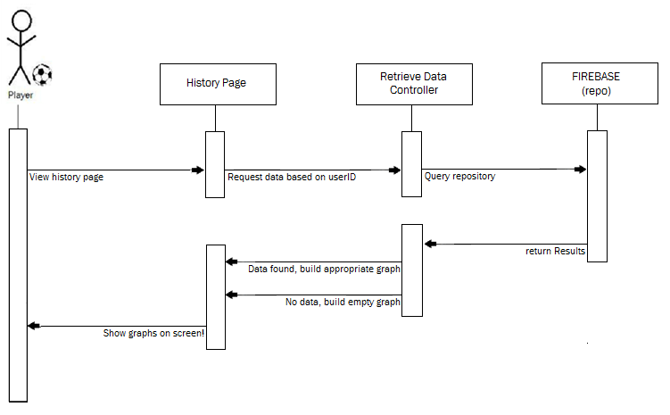
SEQUENCE DIAGRAMS…
Breakdown of an individual Use Case (User Story #896)
14
14
14

Slide 15
SEQUENCE DIAGRAMS…
Breakdown of an individual Use Case (User Story #803)
15
15
15
15

Slide 16
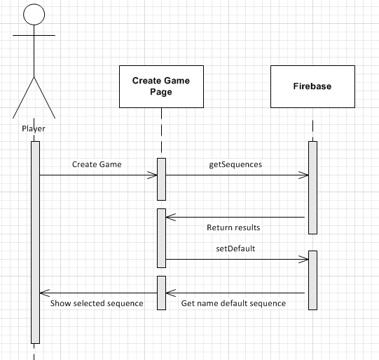
SEQUENCE DIAGRAMS…
Breakdown of an individual Use Case (User Story #912)
16
16
16
16

Slide 17
SEQUENCE DIAGRAMS…
Breakdown of an individual Use Case (User Story #830)
17
17
17
17

Slide 18
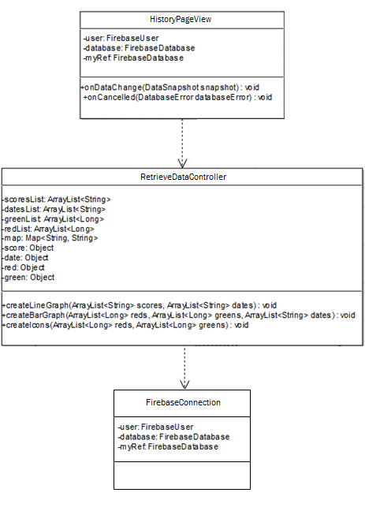
CLASS DIAGRAM
Breakdown of an individual
Use Case (User Story #896)
18
18
18

Slide 19
CLASS DIAGRAM
Breakdown of an individual
Use Case (User Story #803)
19
19
19

Slide 20
CLASS DIAGRAM
Breakdown of an individual
Use Case (User Story #830)
20
20
20

Slide 21
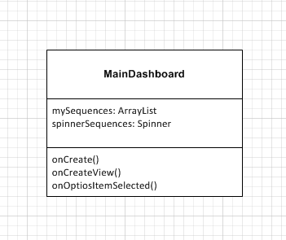
CLASS DIAGRAM
Breakdown of an individual
Use Case (User Story #912)
21
21
21

Slide 22
TEST CASES…
Test Case #3 (User Story #830)
Purpose: Test that a new team is being saved in the database
Precondition:User is logged in and from the Main Coach Dashboard clicks on the plus button in the bottom right corner, then fills out the form for a new team and clicks on the save button
Expected Result: The app returns to the teams list view and shows new team on the list
Actual Result: Same as expected. Status: PASS
Test Case #1 (User Story #896)
Purpose: Test the accuracy of the database retrieval for a player that has saved game data
Precondition: User plays new game and saves results. Then rechecks the “History
Expected Result: The graphs are created with new score intact
Actual Result: Same as expected.
Status: PASS
*one ex. of each user story previously mentioned
Test Case #2 (User Story #803)
Purpose: Test the beat timer mod
Precondition: User is already logged in and there is arduinos connected
Expected Result: Player can play a game by touching the pressure sensors and the pads will change color each ‘S’ Seconds
Actual Result: Same as expected.
Status: PASS
Test Case #4 (User Story #912
Purpose: Test select/save sequence from dropdown
Precondition:User is in Create Game page
Expected Result: User selects sequence from dropdown and is set to default in the database
Actual Result: Same as expected.
Status: PASS
22
22
22

Slide 23
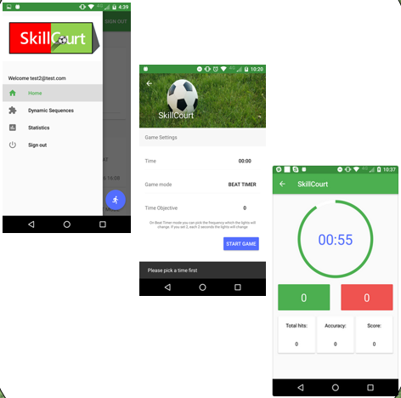
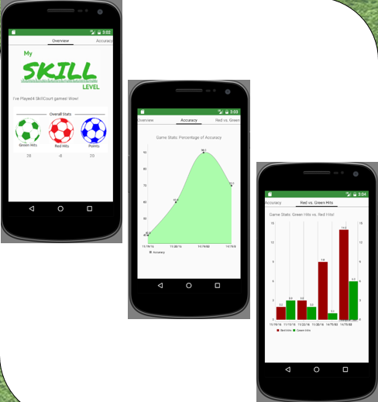
Some screenshots…
23
23
23

Slide 24

HIGH LEVEL DEMO…
(Double Click to play)

